Slide 1
Machine Learning
Week4

Slide 2
Learning Objective
Sentiment analysis
Text similarity
Text summarization
Supervised label assignment methods:
Naïve Bayes
K nearest neighbor
Support vector machine(SVM)

Slide 3
Examples of text categorization
Binary labels
“Spam” / “Not spam”
Topic labels
“Finance” / “Sports” / “Asia”
Opinion labels
“Like” / “Hate” / “Neutral”
Author labels
“Shakespeare” / “Marlowe” / “Ben Jonson”

Slide 4
Sentiment analysis
Sentiment analysis is a binary label method. The purpose of the sentiment analysis is to be able to automatically classify a tweet as a positive or negative sentiment.
First we should train the classifier using the manually classified tweets.

Slide 5
Learning Objective
This is good book ➔ Positive
This is good book and I like it ➔ More positive
This is bad book ➔ Negative
The first chapter is good but the rest is terrible ➔ Negative

Slide 6
Sentiment Dictionary
Good ➔ 2
Like ➔ 1
Bad ➔ -2
Terrible ➔ -3
The dictionary can be generated using the internal source or using the pre-provided one such as AFINN

Slide 7
Sentiment Dictionary
http://www2.imm.dtu.dk/pubdb/views/publication_details.php?id=6010
AFINN is a pre assign database which score the words positive an negative.
AFINN-111: Newest version with 2477 words and phrases.
AFINN-96: 1468 unique words and phrases on 1480 lines. Note that there are 1480 lines, as some words are listed twice. The word list in not entirely in alphabetic ordering.

Slide 8
Sentiment scoring-approach1
This is good book ➔ 2 ➔ Positive
This is good book and I like it ➔ 3 ➔ More positive
This is bad book ➔ -2 ➔ Negative
The first chapter is good but the rest is terrible ➔ 2-3=-1 ➔Negative
The words who does not scored in the dictionary will be labeled as 0.

Slide 9
Sentiment scoring-approach2
This is good book ➔ {0,2} ➔ Positive
This is good book and I like it ➔ {0,3} ➔ More positive
This is bad book ➔ {-2,0} ➔ Negative
The first chapter is good but the rest is terrible ➔ {-3,2} ➔Negative
The words who does not scored in the dictionary will be labeled as 0.

Slide 10
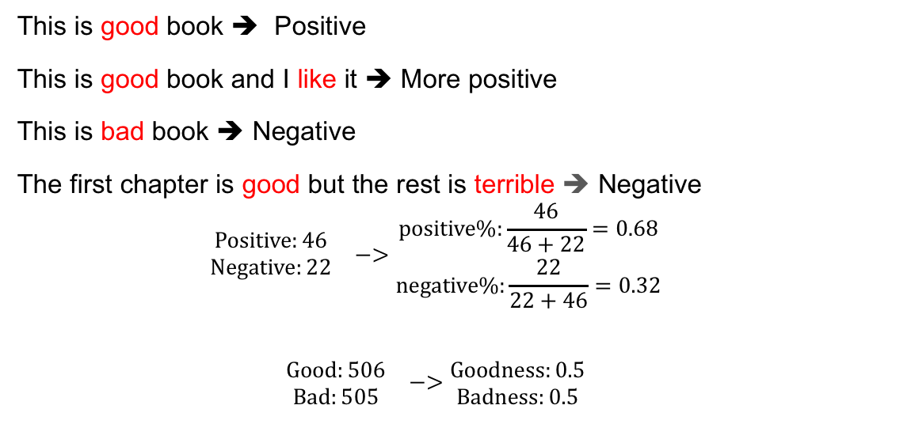
Bag of word model
This is good book ➔ Positive
This is good book and I like it ➔ More positive
This is bad book ➔ Negative
The first chapter is good but the rest is terrible ➔ Negative
$$\begin{matrix}\begin{matrix}Positive:46 \\ Negative:22\end{matrix} & −>\begin{matrix}positive\%:\frac{46}{46+22}=0.68 \\ negative\%:\frac{22}{22+46}=0.32\end{matrix}\end{matrix}$$
$$\begin{matrix}\begin{matrix}Good:506 \\ Bad:505\end{matrix} & −>\begin{matrix}Goodness:0.5 \\ Badness:0.5\end{matrix}\end{matrix}$$

Slide 11
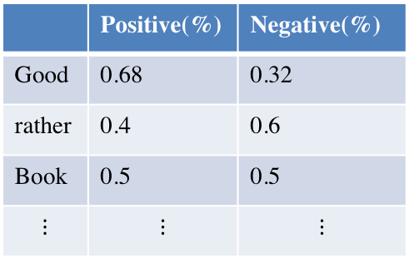
Bag of word model
Generate the score table to the new sentence
Total 5.33 4.2
-> The review is positive
 | Positive(%) | Negative(%)
Good | 0.68 | 0.32
rather | 0.4 | 0.6
Book | 0.5 | 0.5
$$⋮$$ | $$⋮$$ | $$⋮$$

Slide 12
Text mining-ML algorithms
Split data to train and test.
Split the sentences to the words.
Apply the machine learning classifier like Naïve Bayes, support vector machine, maximum entropy on the train data.
Find the accuracy of the classifier using test data

Slide 13
Sentiment analysis-Flowchart
Classified Tweets
Word Feature
Feature selection
Training
set
New
Tweet
Feature selection
Classifier
New Tweet classification

Slide 14
Text Summarization
Abstractive Summarization:
Abstractive methods select words based on semantic understanding, even those words did not appear in the source documents.
It aims at producing important material in a new way in order to generate a new shorter text that conveys the most critical information from the original text.
Input document
understand context semantics
Human supervision
Create own summary

Slide 15
Text Summarization
Extractive Summarization:
Attempt to summarize articles by selecting a subset of words that retain the most important points.
weights the important part of sentences and uses the same to form the summary.
Input article
Split into sentences
Remove stop words Build a similarity matrix
Generate rank based on matrix
Pick top N sentences for summary.

Slide 16
Bays Theory
Naïve bays is based on the frequency table. This classifier is based on Bay’s theory with independent assumption between predicators.
Naïve bays is very easy to build and despite of its easy modeling it outperform many other classifier by iteration and improving the algorithm.

Slide 17
Discriminative vs. Generative algorithm
Discriminative: Discriminative learn P(y|x) directly probability of y given x such as logistic regression, where x are the features and y is dependent variable.
Generative: Generative learns p(x|y) and p(y) then we calculate P(y|x) such as naïve Bayes
Generative algorithm may works better if we have fewer training examples.
Generative algorithm are usually very easy to implement.

Slide 18
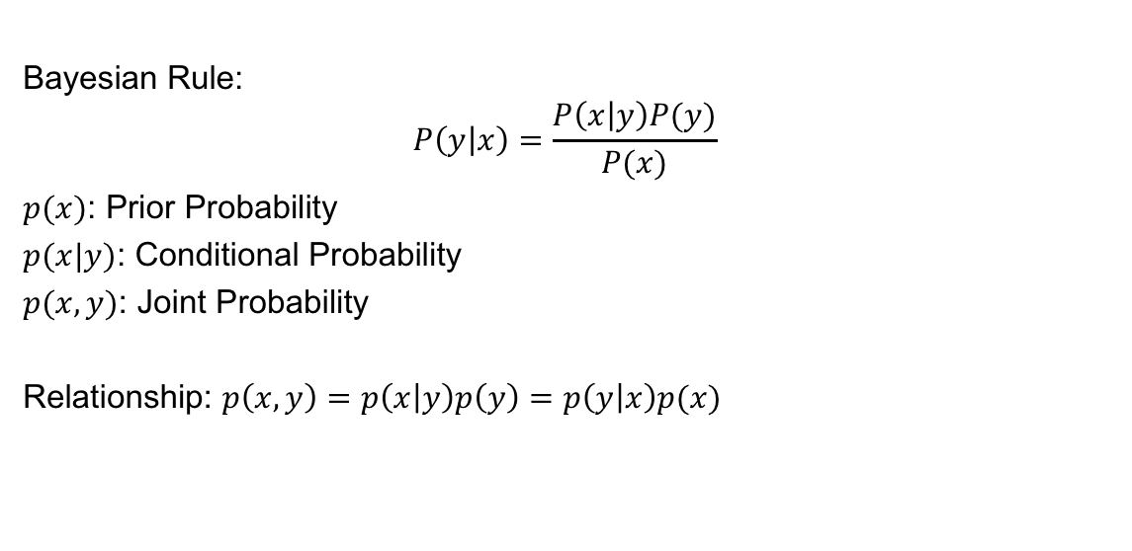
Most common classifier using in Text mining
Bayesian Rule:
$$P\left(y | x\right)=\frac{P\left(x | y\right)P(y)}{P(x)}$$
$p(x)$: Prior Probability
$p(x|y)$: Conditional Probability
$p(x,y)$: Joint Probability
Relationship: $p\left(x,y\right)=p\left(x | y\right)p\left(y\right)=p\left(y | x\right)p(x)$

Slide 19
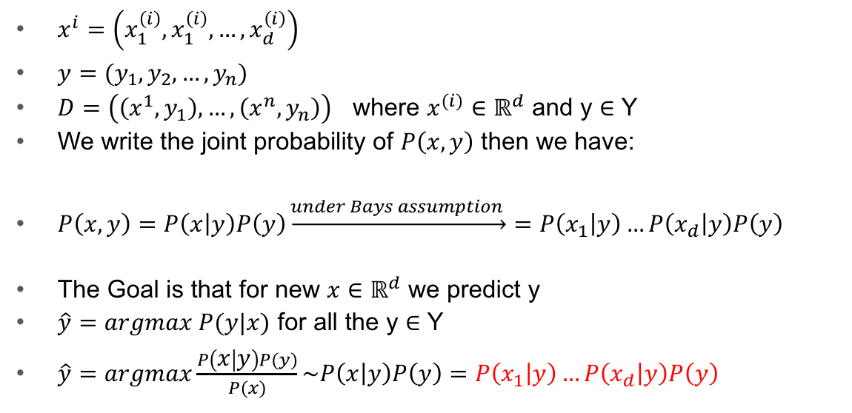
Naïve Bayes
$x^{i}=\left(x_{1}^{\left(i\right)},x_{1}^{\left(i\right)},…,x_{d}^{\left(i\right)}\right)$
$y=(y_{1},y_{2},…,y_{n})$
$D=\left(\left(x^{1},y_{1}\right),…,\left(x^{n},y_{n}\right)\right)$ where $x^{(i)}∈ℝ^{d}$ and y $∈$ Y
We write the joint probability of $P\left(x,y\right)$ then we have:
$P\left(x,y\right)=P\left(x | y\right)P\left(y\right)\underset{→}{under Bays assumption }=P\left(x_{1} | y\right)…P\left(x_{d} | y\right)P\left(y\right)$
The Goal is that for new $x∈ℝ^{d}$ we predict y
$\hat{y}=argmax P(y|x)$ for all the y $∈$ Y
$\hat{y}=argmax\frac{P\left(x | y\right)P(y)}{P(x)}\sim P\left(x | y\right)P\left(y\right)=P\left(x_{1} | y\right)…P\left(x_{d} | y\right)P\left(y\right)$

Slide 20
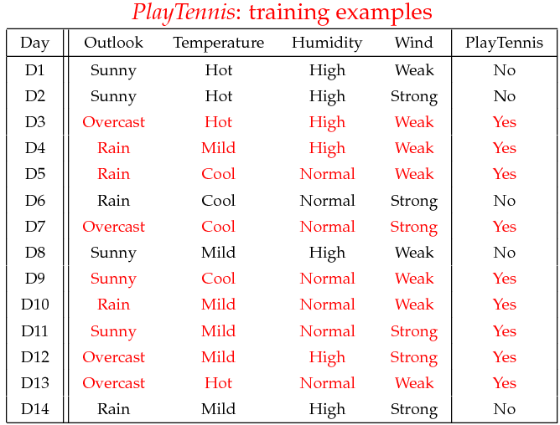
Naive Bayes-assumption

Slide 21

Naive Bayes-assumption
$$P\left(x | y\right)=P\left(Sunny | Yes\right)=\frac{2}{9} P\left(x\right)=P\left(Sunny\right)=\frac{5}{14}$$
$$P\left(y\right)=P\left(Yes\right)=\frac{9}{14}$$
$$P\left(y | x\right)=P\left(Yes|Sunny\right)=\frac{P\left(Sunny|Yes\right)P(yes)}{P(sunny)}=\frac{\frac{2}{9}×\frac{9}{14}}{\frac{5}{14}}$$

Slide 22
Naive Bayes-assumption

Slide 23
Naïve Bayes
x=(Outlook=Sunny, Temperature=Cool, Humidity=High, Wind=Strong)
What is y?
P(Yes|x) ≈ (P(Sunny|Yes)P(Cool|Yes)P(High|Yes)P(Strong|Yes))P(play=Yes) =0.0053
P(No|x) ≈ (P(Sunny|No) P(Cool|No)P(High|No)P(Strong|No))P(Play=No) = 0.0206
Zero Frequency Problem:
Problem: If one of the probability does not occur p(xIy)=0 then p(y|x)=0
Solution: Add 1 to all the accounts

Slide 24
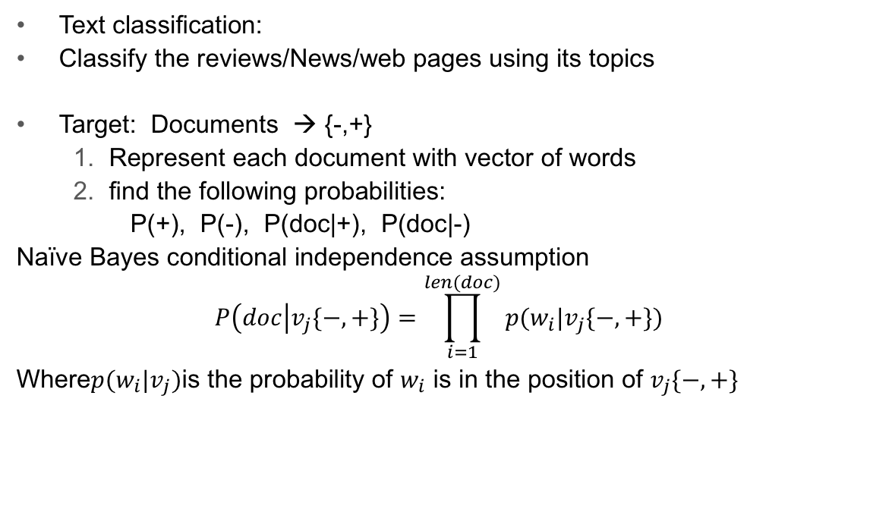
Naïve Bayes
Text classification:
Classify the reviews/News/web pages using its topics
Target: Documents → {-,+}
Represent each document with vector of words
find the following probabilities:
P(+), P(-), P(doc|+), P(doc|-)
Naïve Bayes conditional independence assumption
$$P\left(doc | v_{j}\{−,+\}\right)=\prod_{i=1}^{len(doc)}{p(w_{i}|v_{j}\{−,+\})}$$
Where$p(w_{i}|v_{j})$is the probability of $w_{i}$ is in the position of $v_{j}\{−,+\}$

Slide 25
Naïve Bayes
Assume the following rating:
Bag of words: I, love, the , movie, don’t, like, hate, great, acting, good
Review | Rate
I love the movie | +
I don’t like the movie | -
I hate the movie | -
Great acting, good movie | +

Slide 26
Naïve Bayes
Matrix of word representation:
I, love, the , movie, don’t, like, hate, great, acting, good
Doc. | I | Love | the | movie | Don’t | like | hate | great | acting | good | Rate
1 | 1 | 1 | 1 | 1 | 0 | 0 | 0 | 0 | 0 | 0 | +
2 | 1 | 0 | 1 | 1 | 1 | 1 | 0 | 0 | 0 | 0 | -
3 | 1 | 0 | 1 | 1 | 0 | 0 | 1 | 0 | 0 | 0 | -
4 | 0 | 0 | 0 | 1 | 0 | 0 | 0 | 1 | 1 | 1 | +

Slide 27
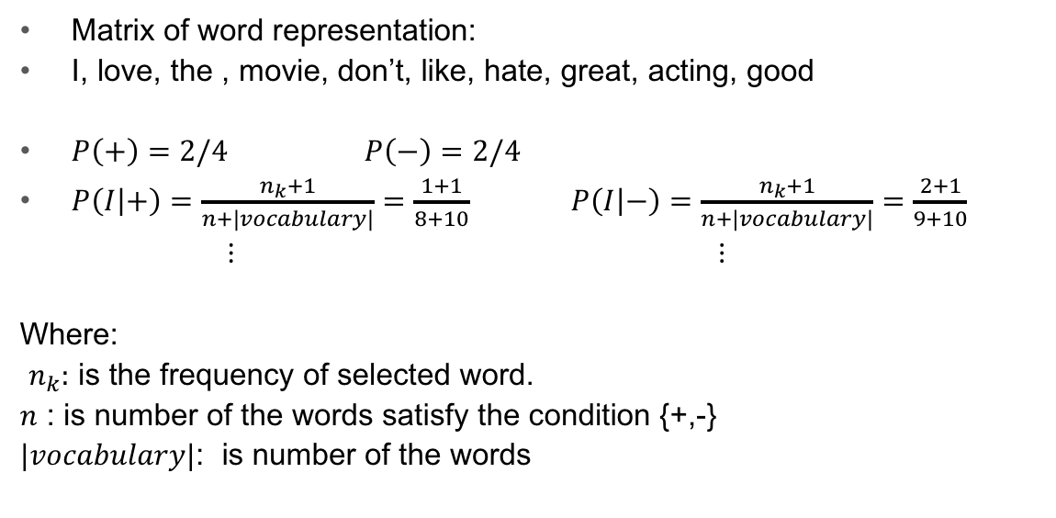
Naïve Bayes
Matrix of word representation:
I, love, the , movie, don’t, like, hate, great, acting, good
$P\left(+\right)=2/4$ $P\left(−\right)=2/4$
$P\left(I | +\right)=\frac{n_{k}+1}{n+|vocabulary|}=\frac{1+1}{8+10}$ $P\left(I | −\right)=\frac{n_{k}+1}{n+|vocabulary|}=\frac{2+1}{9+10}$
⋮ ⋮
Where:
$n_{k}:$ is the frequency of selected word.
$n$ : is number of the words satisfy the condition {+,-}
$|vocabulary|$: is number of the words

Slide 28
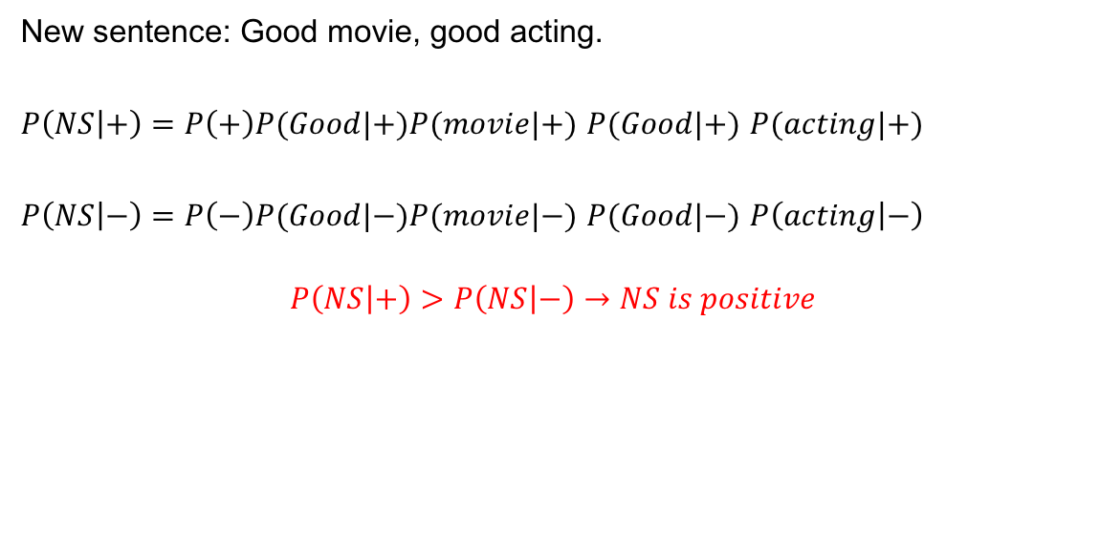
Naïve Bayes
New sentence: Good movie, good acting.
$P\left(NS | +\right)=P\left(+\right)P(Good|+)P(movie|+)$ $P(Good|+)$ $P(acting|+)$
$P\left(NS | −\right)=P\left(−\right)P(Good|−)P(movie|−)$ $P(Good|−)$ $P\left(acting | −\right)$
$$P\left(NS | +\right)>P\left(NS | −\right)→NS is positive$$

Slide 29
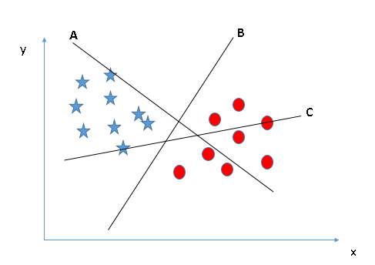
SVM
The rule is to identify the right hyper-plane.
Select the hyper-plane which segregates
the two classes the best”.

Slide 30
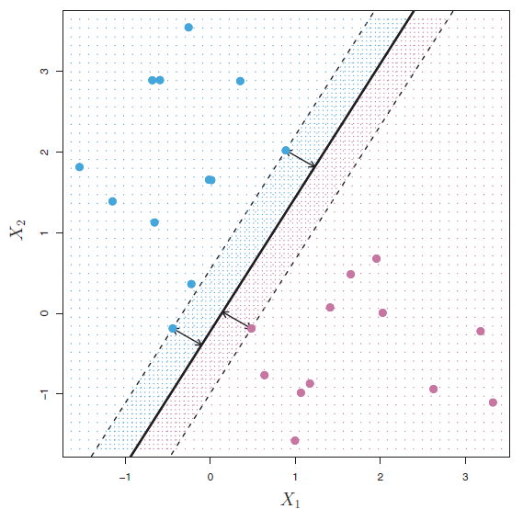
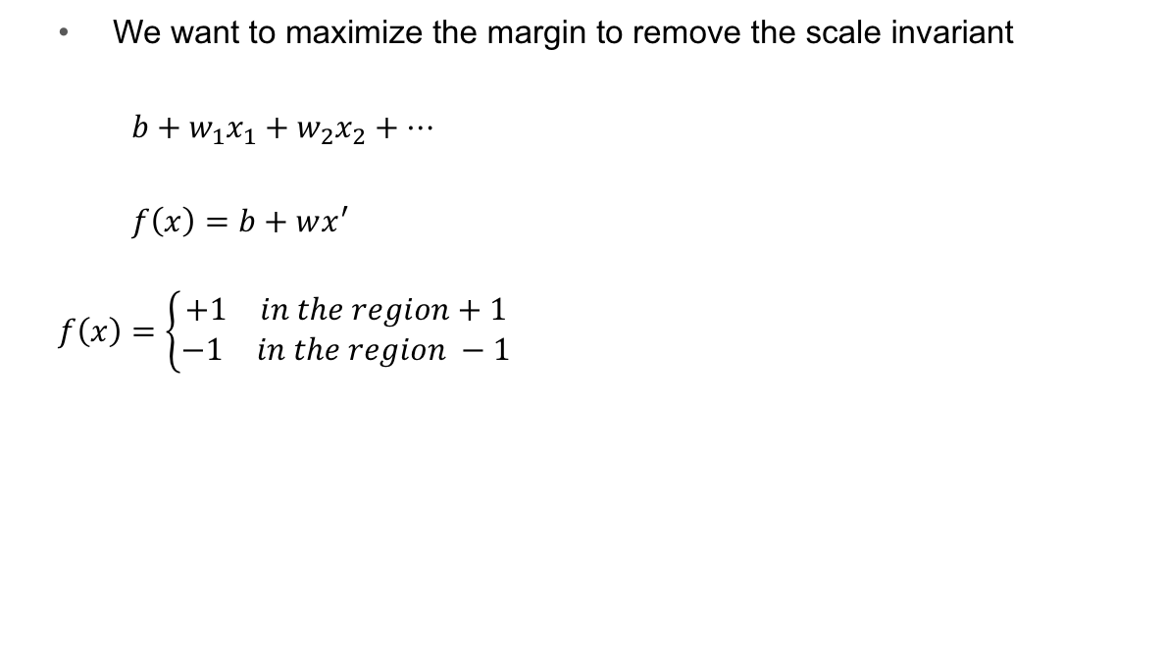
SVM
We want to maximize the margin to remove the scale invariant
$b+w_{1}x_{1}+w_{2}x_{2}+…$
$f\left(x\right)=b+wx^{′}$
$$f\left(x\right)=\left\{\begin{aligned}\begin{matrix}+1 & in the region+1\end{matrix} \\ \begin{matrix}−1 & in the region −1\end{matrix}\end{aligned}\right.$$
Region 1
Region -1
f(x)=0

Slide 31
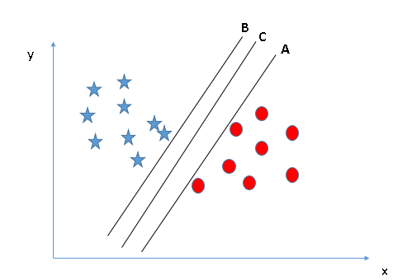

SVM
We want to maximize the margin to remove the scale invariant
$wx^{−}+b=−1$
${wx}^{+}+b=1$
$x^{+}=x^{−}+rw$
$$→w\left(x^{−}+rw\right)+b=+1$$
$wx^{−}+r{\left\|w\right\|}^{2}+b=+1$
$r{\left\|w\right\|}^{2}−1=+1$
$r=\frac{2}{{\left\|w\right\|}^{2}}$
$$Margin=\left\|x^{+}−x^{−}\right\|=\left\|rw\right\|=\frac{2}{\sqrt{w^{T}w}}$$
f(x)=0
margin
rw
f(x)=1
f(x)=-1

Slide 32
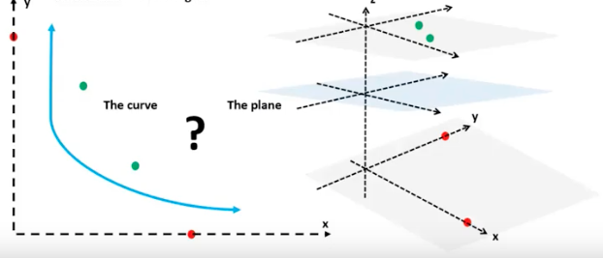
SVM-kernel trick
The hyperplane which separate the planes might be a non linear function such as xy, y² +x²,…

